Slide 1

Furniture Sales Forecasting
By - Diwakar Singh
Profile – Machine Learning Intern Batch Name: MIP-ML-09

Slide 2

Problems Statement
For a retail furniture store, predicting future sales is critical to avoiding inventory issues like overstocking or under-stocking. The challenge lies in utilizing time series data from the superstore dataset to forecast furniture sales for the next year accurately. This predictive insight ensures an optimal customer experience, avoids losses, and maintains store sustainability.

Slide 3
Understanding Time Series Data
Project
Objectives
Checking Components of Time Series
Forecasting Techniques
Visualization in Time Series

Slide 4
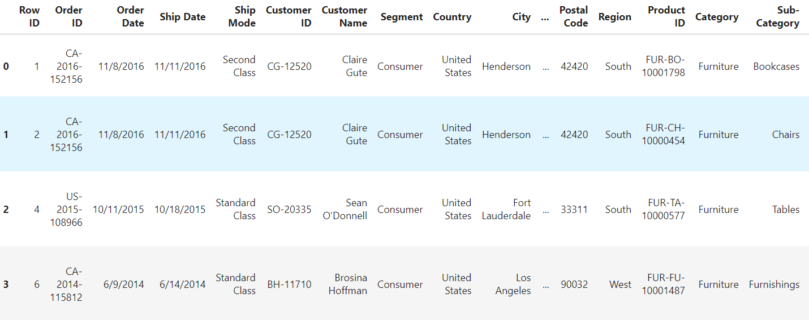
Data Exploration...
The very First step of Data Analysis: Viewing the data and finding the obvious patterns, and visualizing how out data actually looks like, how can use it to get good results.

Slide 5
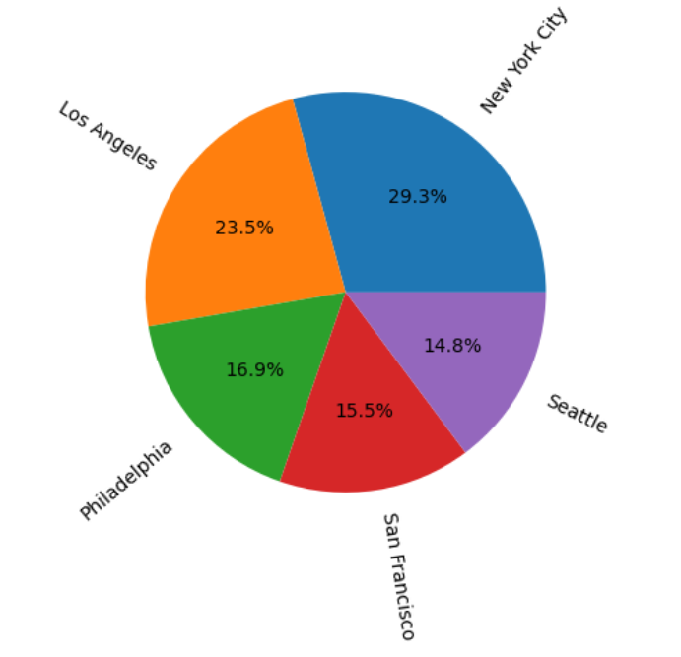
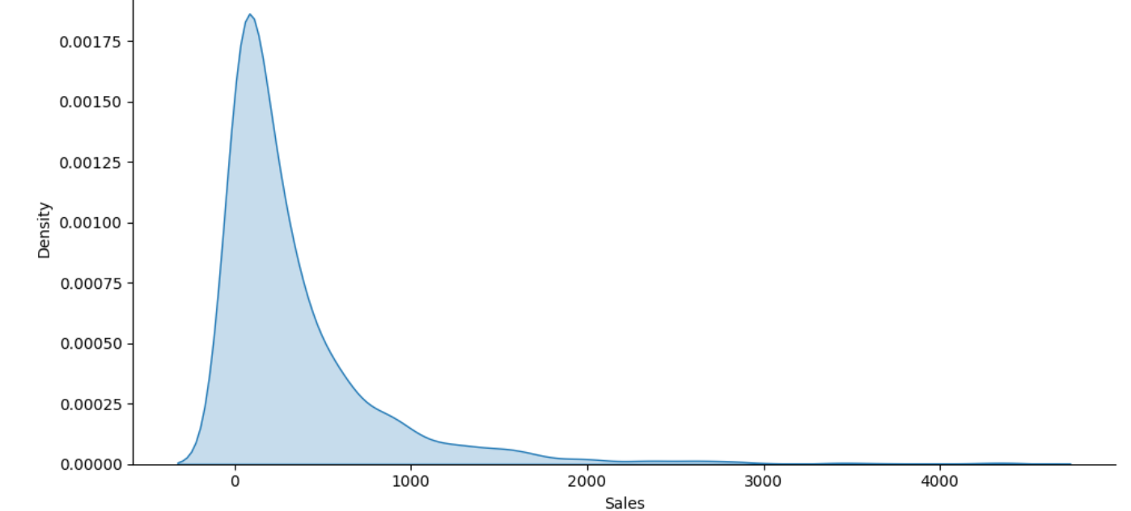
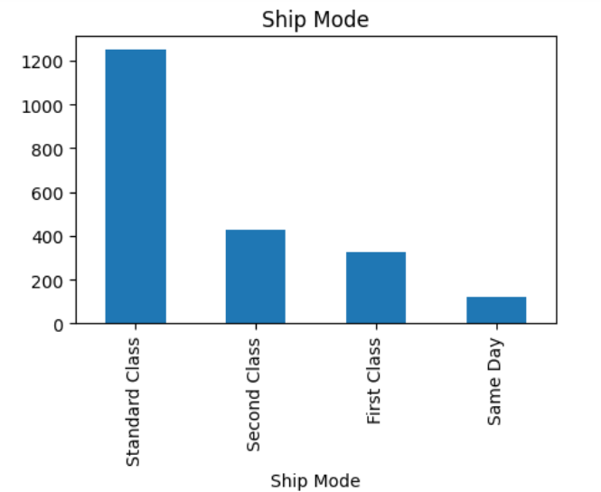
Exploratory Data Analysis (EDA)
Analysis of Data using Visual Representation of Graphs, finding trends and patterns in the data.

Slide 6
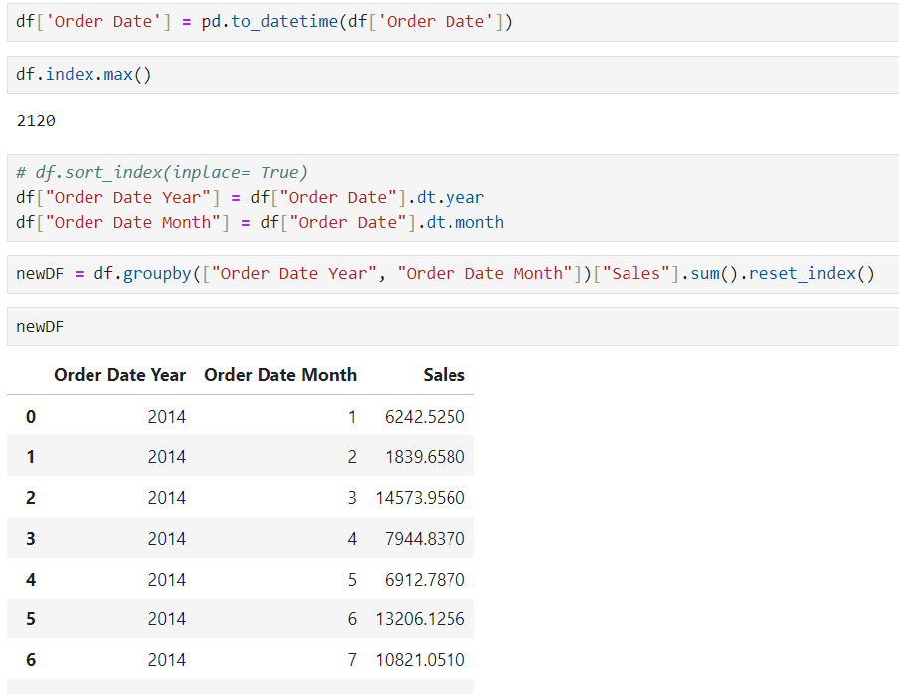
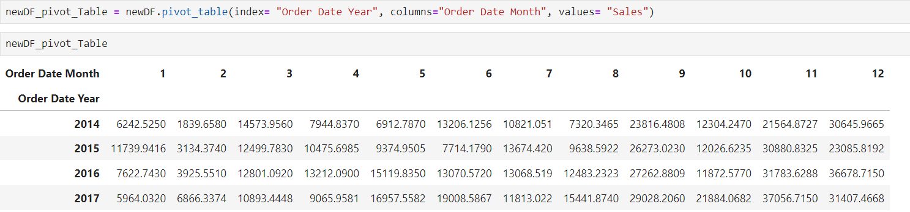
Feature Engineering
Feature engineering is shaping raw data into features that power machine learning models.

Slide 7
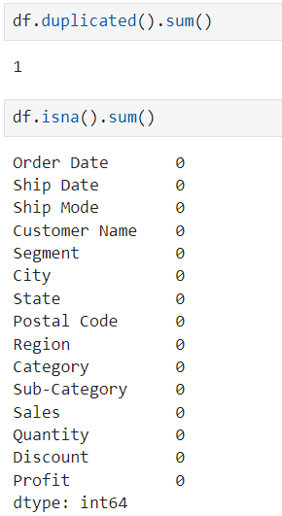
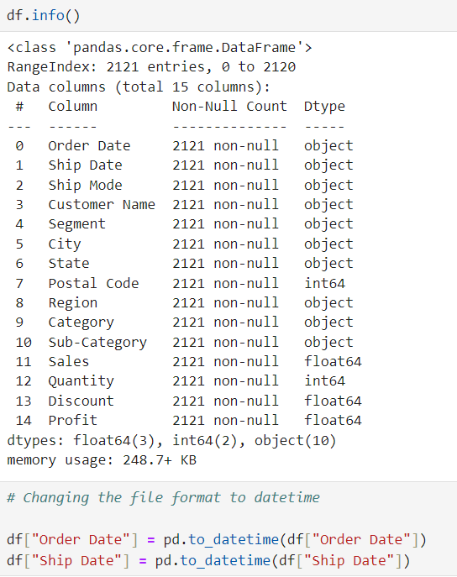
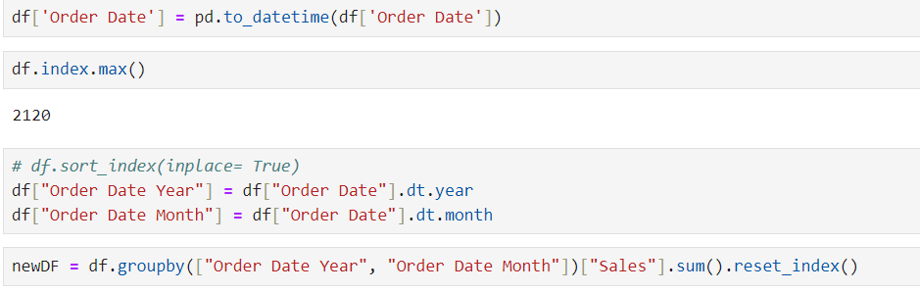
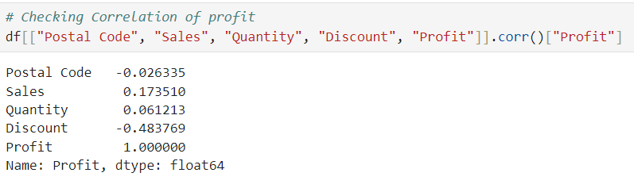
Data Pre-Processing
Data preprocessing is cleaning and preparing raw data for machine learning algorithms.

Slide 8
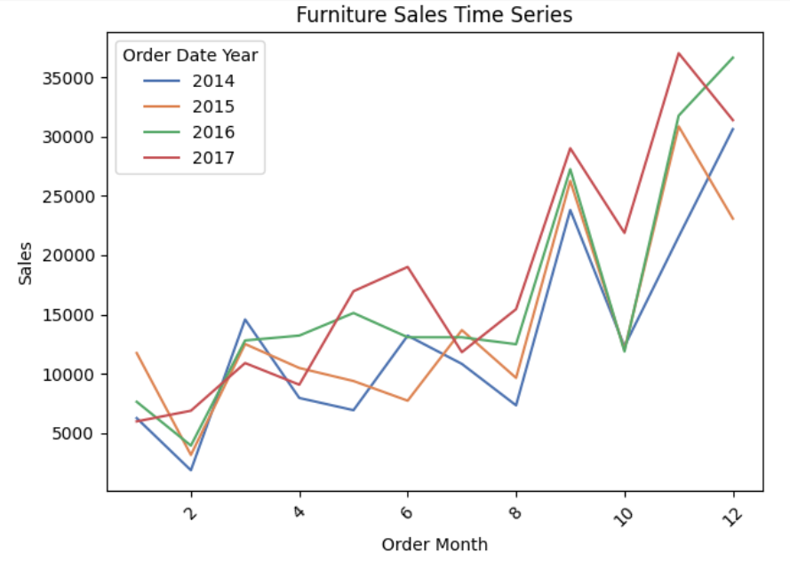
Time Series Forecasting

Slide 9
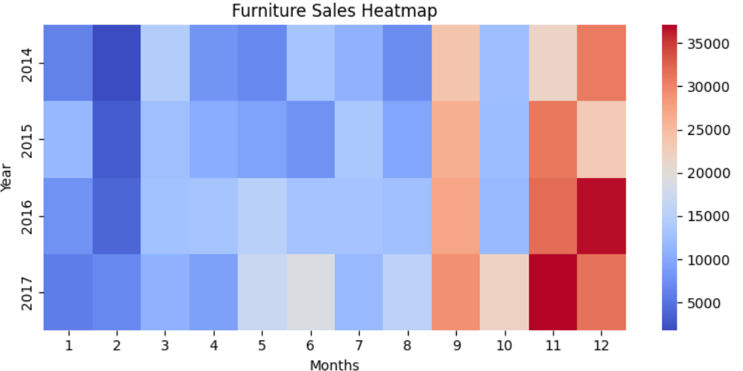
Time Series Forecasting

Slide 10

Conclusion
Furniture sales show [trend, e.g., upward] trend with potential seasonal patterns. Utilize these insights for informed inventory management and targeted marketing strategies.

Slide 11
Thank You !!!

